Slide 1
Security Principles of Information Security
Lecture 2

Slide 2
Principles of Information Security
Confidentiality: Ensuring information is accessible only to authorized users.
Integrity: Protecting data from unauthorized changes to keep it accurate and reliable.
Availability: Making sure systems and data are accessible when needed.
Authenticity: Verifying the genuineness and origin of information or users.
Non-repudiation: Making sure someone cannot deny doing an action, like signing a document or sending a message.
Accountability: Holding users responsible for their actions via logs and monitoring.
Privacy: Safeguarding personal or sensitive data from misuse or overexposure.
Least Privilege: Giving users only the minimum access required for their tasks.
Defense-in-Depth: Applying multiple layers of security controls for protection.
Risk Management: Identifying, assessing, and mitigating potential security risks

Slide 3
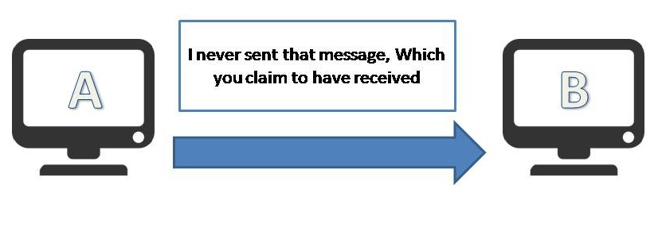
Non-Repudiation
Repudiation in cybersecurity refers to the denial by a party of having performed a particular action, such as sending a message, initiating a transaction, or making changes to a system. This can be problematic in cases where sensitive data is exchanged, and there’s a need to verify that specific actions were performed by the authorized individual or system.

Slide 4
Non-Repudiation
The principle of non-repudiation ensures that the sender of the message cannot later deny that he sent that message and that the recipient of the message cannot deny that he received the message. In other words, we can say that after sending or receiving any message, the party cannot later deny having done so, nor can they deny the content or accuracy of the message.
For example, a handwritten signature ensures non-repudiation because the signer cannot deny the agreement. Another example: if an individual sends an email or initiates a transaction, non-repudiation ensures they cannot later claim non-involvement.
Any individual or organization uses a digital signature, encryption, audit logs, and time-stamping to ensure non-repudiation

Slide 5
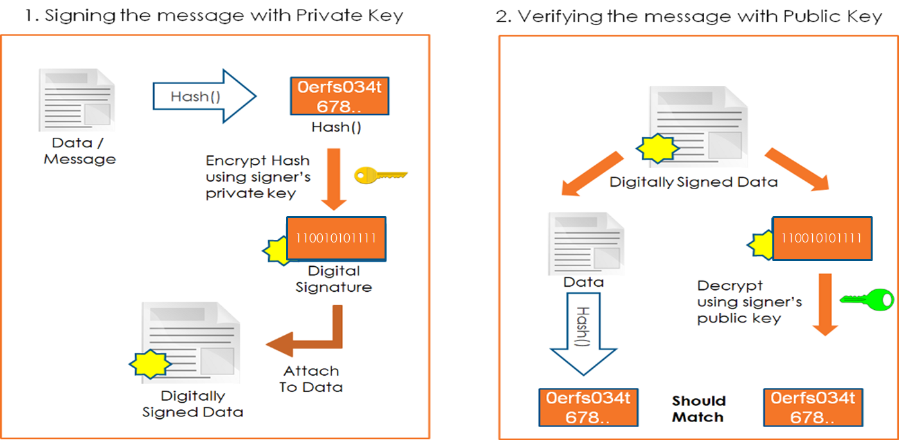
Digital Signatures for Non-Repudiation
When a digital document is signed, a hash function generates a fixed-size string of bytes—a digest that uniquely represents the document’s contents. This hash is then encrypted with the signer’s private key, creating a digital signature.
The recipient can decrypt this signature using the signer’s public key, verifying both the signer’s identity and the document’s integrity.
Any alteration to the document post-signing would result in a different hash, immediately signaling tampering.

Slide 6
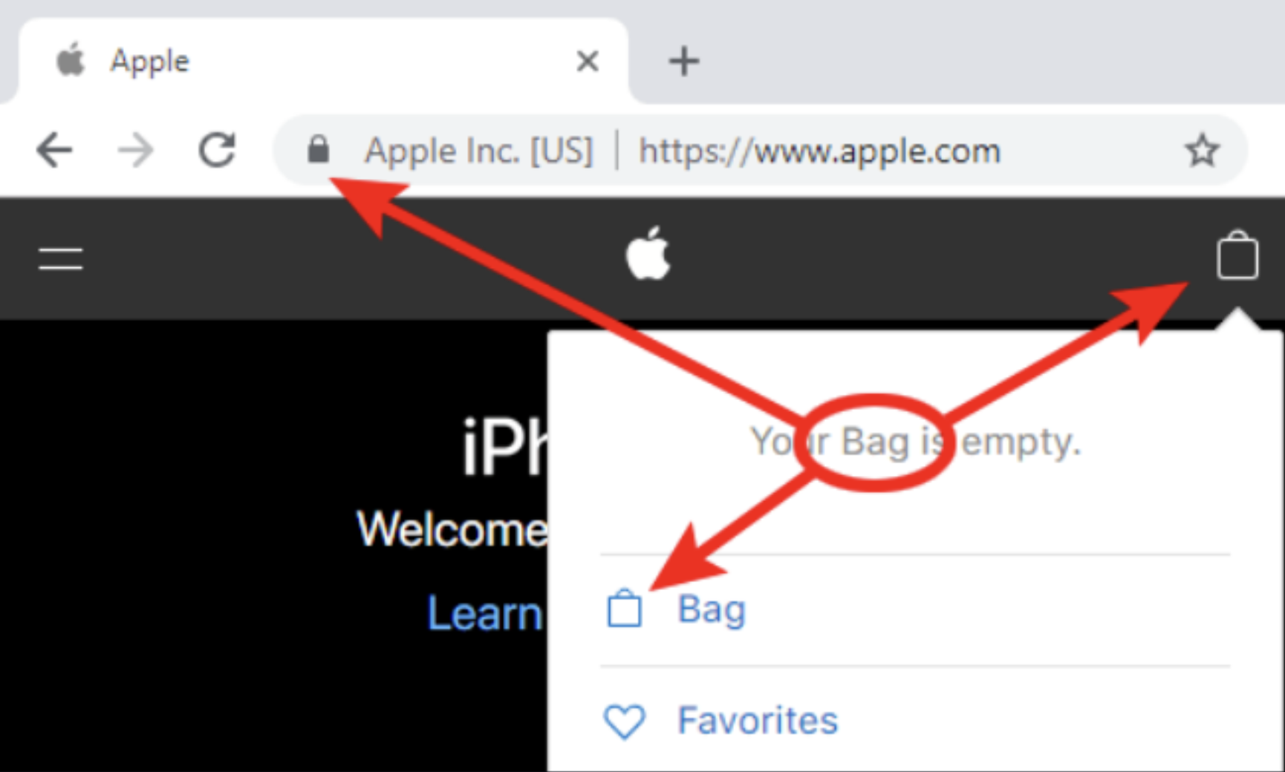
Authenticity
Authenticity refers to the validity and conformance of original information, ensuring that data, communications, and transactions are genuine and untampered with.
It plays a crucial role in preventing unauthorized access and fraud and maintaining trust in digital interactions.
Methods to achieve authenticity include proof of identity, multi-factor authentication, and techniques like hashing, MAC, and HMAC.
Imagine you purchase a product online from a reputable e-commerce website. Before entering your payment details, you notice a padlock icon and "https://" in the website's URL, indicating a secure connection.
This authenticity ensures that the website is legitimate and encrypts your data during transmission, protecting it from unauthorized access or tampering by malicious parties. By verifying these security indicators, you trust that your transaction details are safe and proceed with confidence in making the purchase.

Slide 7
Principles of Authenticity
Authenticity in cybersecurity is essential for maintaining trust and preventing unauthorized access. It involves verifying the origin of data, ensuring its genuineness, and providing confidence in its validity. Key principles of authenticity include:
Origin of Data: Ensuring data originates from its claimed source.
Genuineness and Verifiability: Confirming data, transmissions, and messages are genuine and can be trusted.
Confidence in Validity: Providing assurance in the reliability of transmissions, messages, and message originators.
Multi-Factor Authentication: Using multiple methods to verify user identity and reduce unauthorized access risks.

Slide 8
Ensuring Authenticity in Digital Communications
Ensuring authenticity in digital communications is vital for maintaining trust and preventing unauthorized access. Various methods and technologies can be employed to achieve this goal. Some key approaches include:
Multi-Factor Authentication: Using multiple verification methods, such as passwords, biometric data, and authentication tokens, to confirm user identity.
Hashing and MAC: Employing techniques like hashing, Message Authentication Code (MAC), and Hashed Message Authentication Code (HMAC) to secure data and maintain its authenticity.
Asymmetric Cryptography: Utilizing public and private key pairs for encryption and decryption, ensuring secure data transmission and non-repudiation.
Secure Protocols: Implementing security protocols like SSL, TLS, and HTTPS for encrypted and secure data transmission.

Slide 9

Accountability
Tracing actions and holding individuals responsible
We need to ensure that an authenticated user behaves according to the rules, business conduct, and ethics of the organization. In other words, we need to hold an authenticated user accountable for all his activities.
For example, we can review the organization's records or information to ensure an authenticated user is held responsible for any wrongdoing.
Accountability acts as a deterrent against misbehavior in an environment.
For example, if users know that they are being monitored and will be held accountable for any wrongdoing, they will think twice before breaking any rules or policies of an organization.

Slide 10

Privacy
Safeguarding personal information and respecting privacy rights
When we host parties, we welcome guests into our home. We give them access to the living hall, kitchen, restrooms, and other common areas. However, do we allow them any access to sensitive information such as your social security number (SSN), credit card, and bank account information? No. This information is our private information. This information belongs to only us and must be protected at all costs.

Slide 11
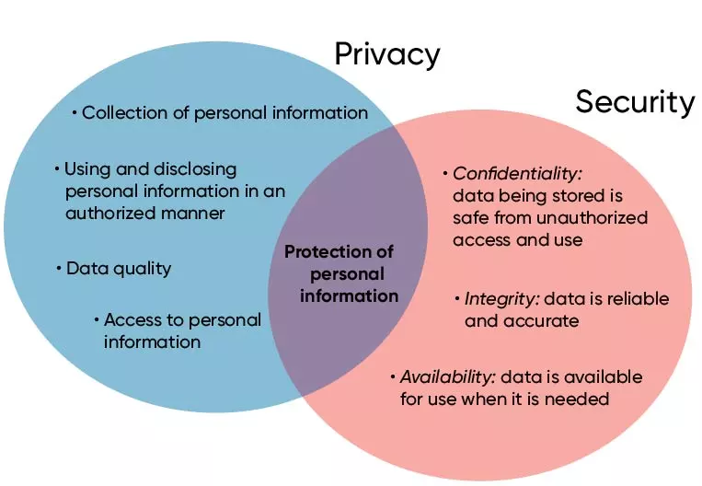
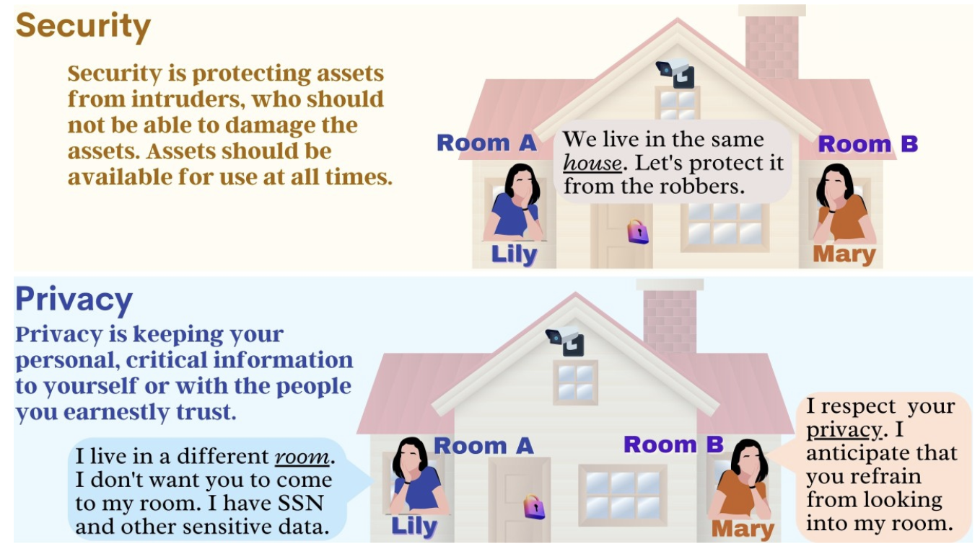
Security vs Privacy
Privacy is about controlling who can access and use personal information, while security is about protecting that information from unauthorized access, tampering, or loss.
Privacy ensures data is collected and shared only in authorized ways, whereas security ensures the data remains confidential, accurate, and available when needed.
Together, privacy and security safeguard personal information from misuse and threats.
For example, in online banking, privacy means only you and your bank can see your account details, while security means those details are protected through encryption and passwords so no hacker can steal or alter them.

Slide 12
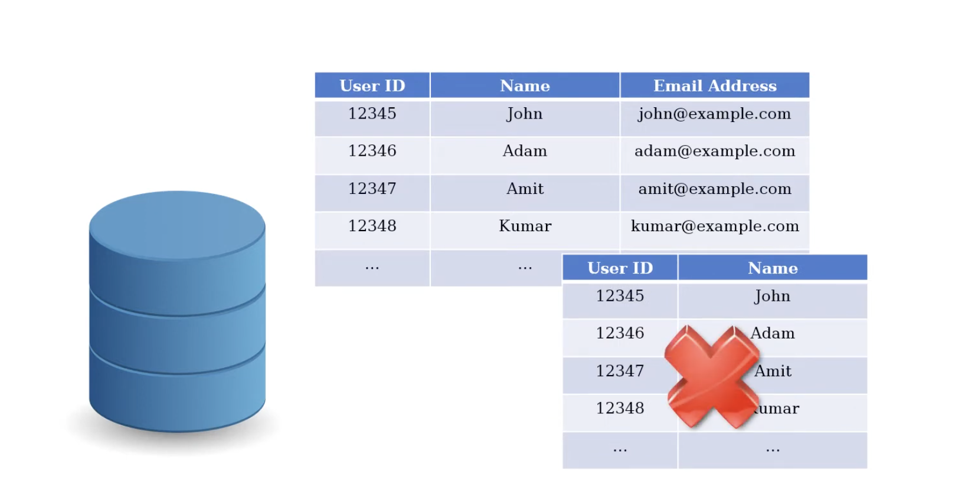
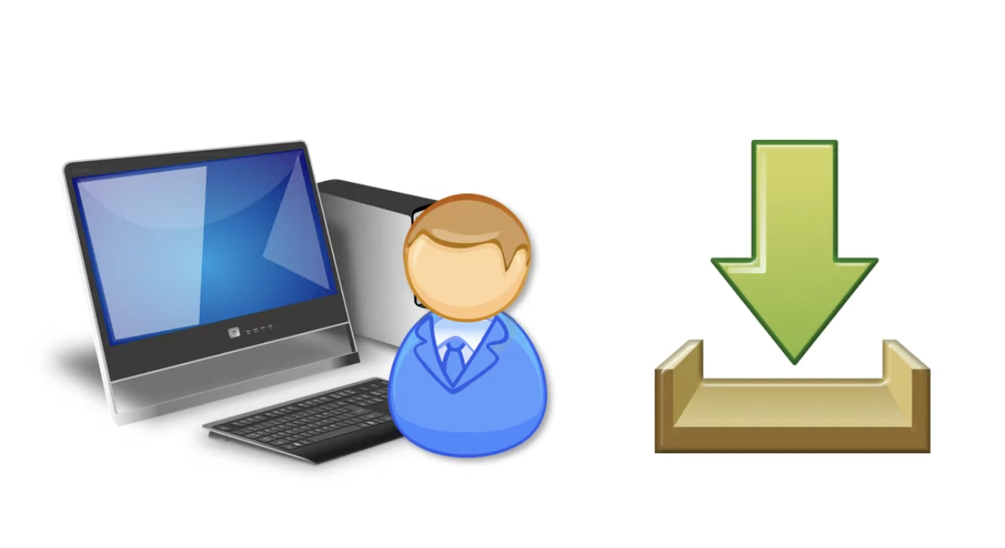
Least Privilege
Granting minimal access privileges based on job roles
For example, if a database user needs to view a table, he should not have the right to update or delete a table. It helps in protecting data and functionality from faults and malicious behavior
Similarly, if a user's job is only to use a system for a particular purpose, then he should not install additional software on the system that requires administrator privileges.
It helps in reducing the cyberattack surface and preventing the spread of malware also

Slide 13
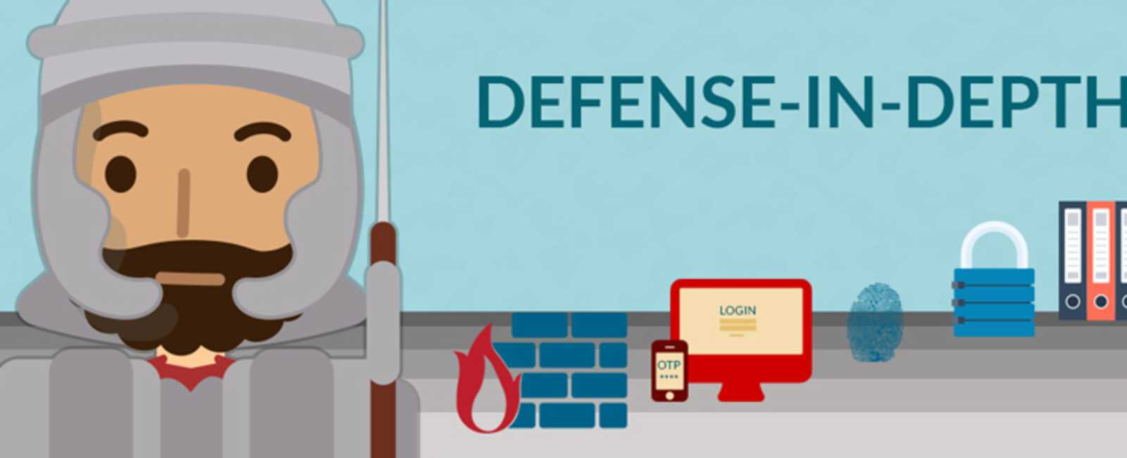
Defense-in-Depth
Defense-in-Depth: Using multiple layers of security measures for protection
For example, Banks use Defense in Depth by having armed guards and vaults to protect money, unlike regular stores that just use alarms and cameras. This way, even if one security measure fails, others are in place to keep the money safe.
Each layer of security is represented by icons: a firewall (flame and brick wall), multi-factor authentication (OTP on a phone), biometric security (fingerprint), encryption or physical locks (padlock), and access control (login screen). These layers work together to defend against threats

Slide 14
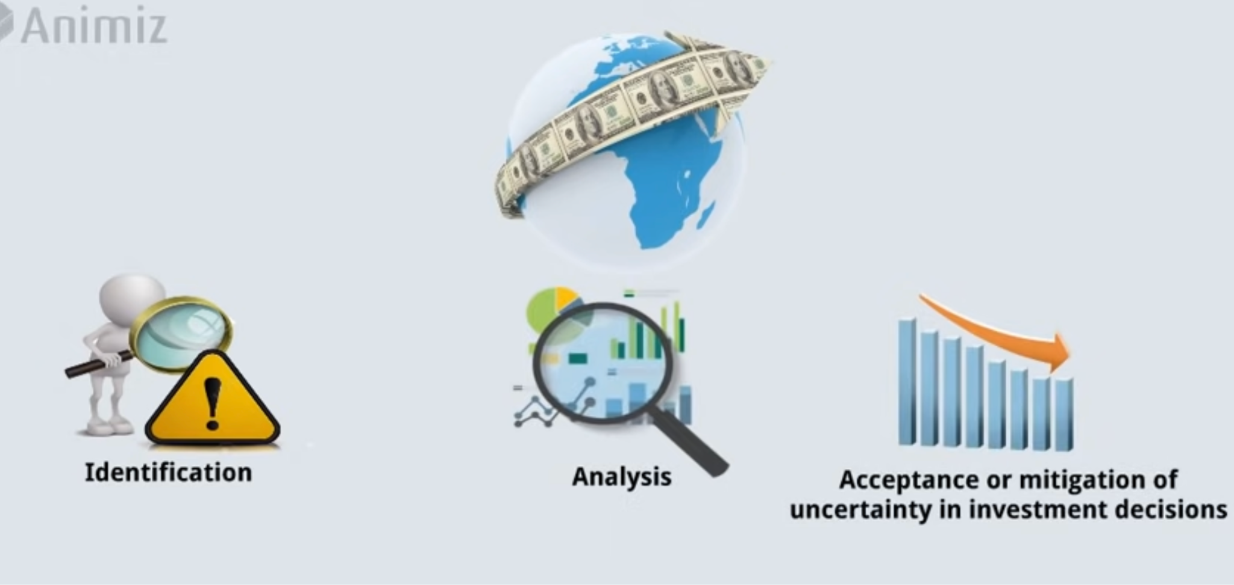
Risk Management
Risk is the potential for loss, damage, or destruction of assets or data.
Risk management in information security refers to the process of identifying, assessing, and mitigating risks to information assets and systems.
Identifying Risks: The company identifies threats such as hacking and phishing that could affect their sensitive customer data.
Assessing Risks: The company understands that a data breach could lead to financial loss and damage their reputation.
Mitigating Risks: The company implements security measures like encryption, strong passwords, and regular updates. They also continuously monitor their systems and review security practices to address new threats and keep data secure.

Slide 15
Thank You

